Slide 1
Lab meeting 22/10/19
3’UTR cloning
Inmunoprecipitation
Flow cytometry

Slide 2
1
Cloning

Slide 3
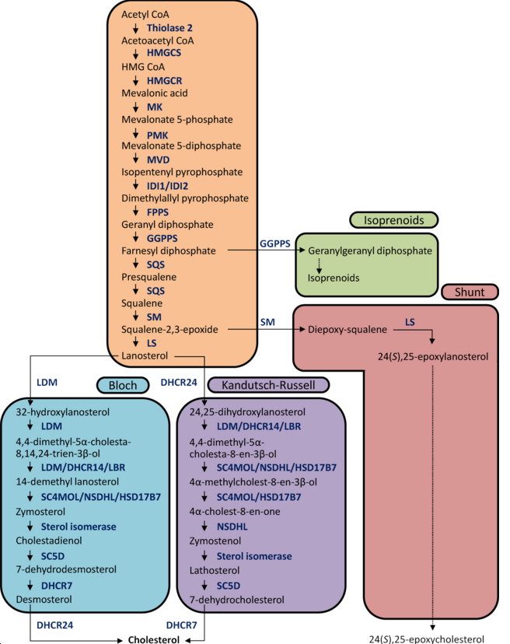
* Mouse 6-mer
miR-7-5p and cholesterol metabolism
* Mouse 7-mer-A1
* Mouse 7-mer-8
* Mouse 8-mer
* Human 6-mer
* Human 7-mer-A1
* Human 7-mer-8
* Human 8-mer
*
*
***
*
*
*
SC4MOL=DESP4=MSMO1
*
*
*
*
*
*
* 5
* 2
*

Slide 4
Cloning – Workflow
3’UTR sequence
+
Primers
Ligation
Primer testing
DH5α transformation
Insert amplification
Miniprep & sequencing
Insert and plasmid digestion
Luciferase assay

Slide 5
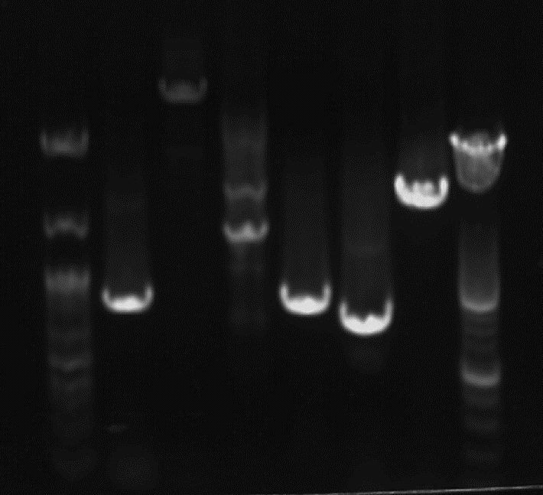
mDHCR24 & mSC5D - primer testing
DHCR24
SC5D
Std
1
2
3
4
5
6
Std
3’UTR segments and mR7 binding site types:
DHCR24 fw1/rv1
DHCR24 fw2/rv2
DHCR24 fw3/rv2
SC5D fw1/rv1
SC5D fw2/rv2
SC5D fw3/rv3 7-merA1
+
2268pb
*
8-mer
1843pb
*
822pb
*
852pb
749pb
7-mer8

Slide 6
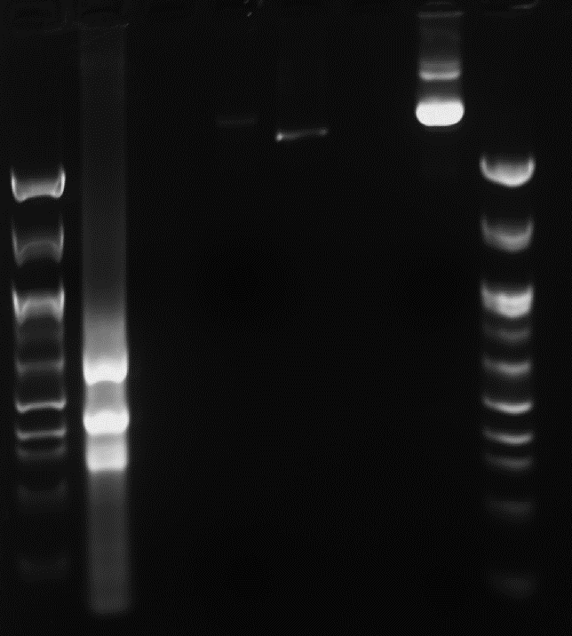
mDHCR24 fw3 reamplification + psiCHECK2
1
2
3
4
5
6
mDHCR24 fw3
Cortado
No cortado
3’UTR ABCA1
Repeat at different temperatures
63ºC
65ºC
?

Slide 7
mDHCR24 fw3 – different temperatures
DHCR24 fw3
Std
1
2
2268pb
??
63ºC
65ºC

Slide 8
mDHCR24 & mSC5D – insert amplification
DHCR24 fw1
SC5D fw1
SC5D fw3
1
2
3
4
5
6
1843pb
822pb
852pb

Slide 9
mDHCR24 & mSC5D – Digestion of psiCHECK 2 and inserts
Inserts
psi-check 2
ABCA1 3’UTR
Inserts
DHCR24 fw1: 822pb
SC5D fw1: 852pb
SC5D fw3: 1842pb
Std
1
2
3
4
5
6
7
Std
Cut
Uncut
Cut
Uncut
1843pb
Transformation doesn’t work
822pb
852pb
Repeat ligation and transformation

Slide 10
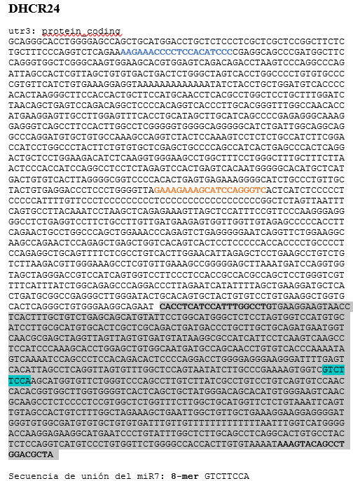
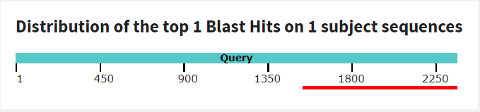
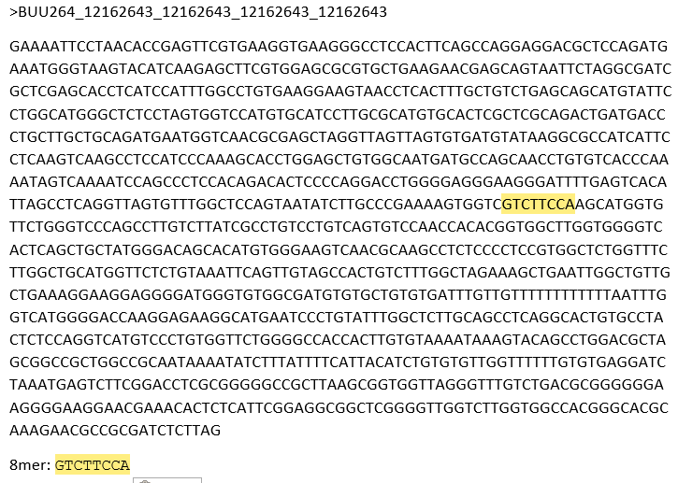
DHCR24 fw1 – DH3 (SeqID BUU264) ~ 822pb
…

Slide 11
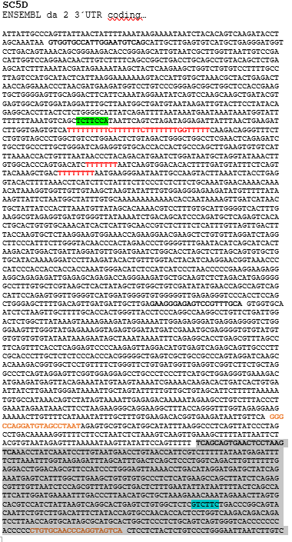
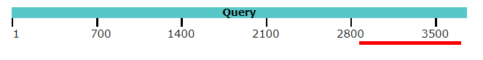
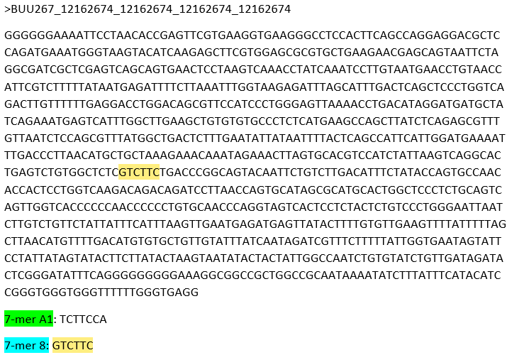
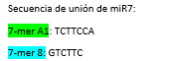
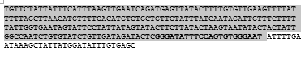
SC5D fw1 – LSD 9 (SeqID BUU267) ~ 852pb
…

Slide 12
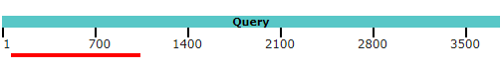
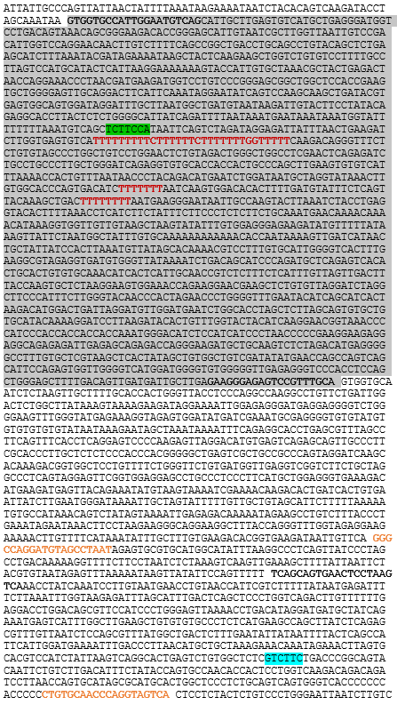
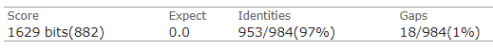
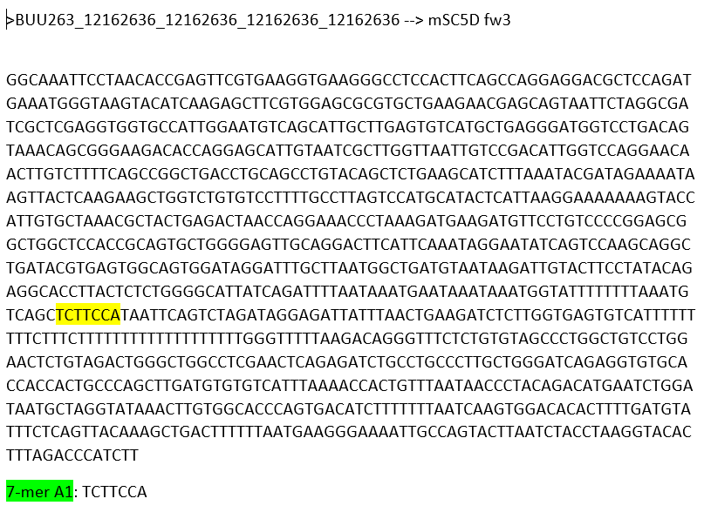
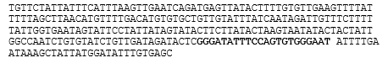
SC5D fw3 – LSD3 (SeqID BUU263) ~ 1843pb
…

Slide 13
mLSS - primers testing
Std
LSS 1
LSS 2
2229pb
2192pb
Inserts
LSS fw1/rv1 --> 2229pb
LSS fw1/rv2 --> 2192pb
7-mer8

Slide 14
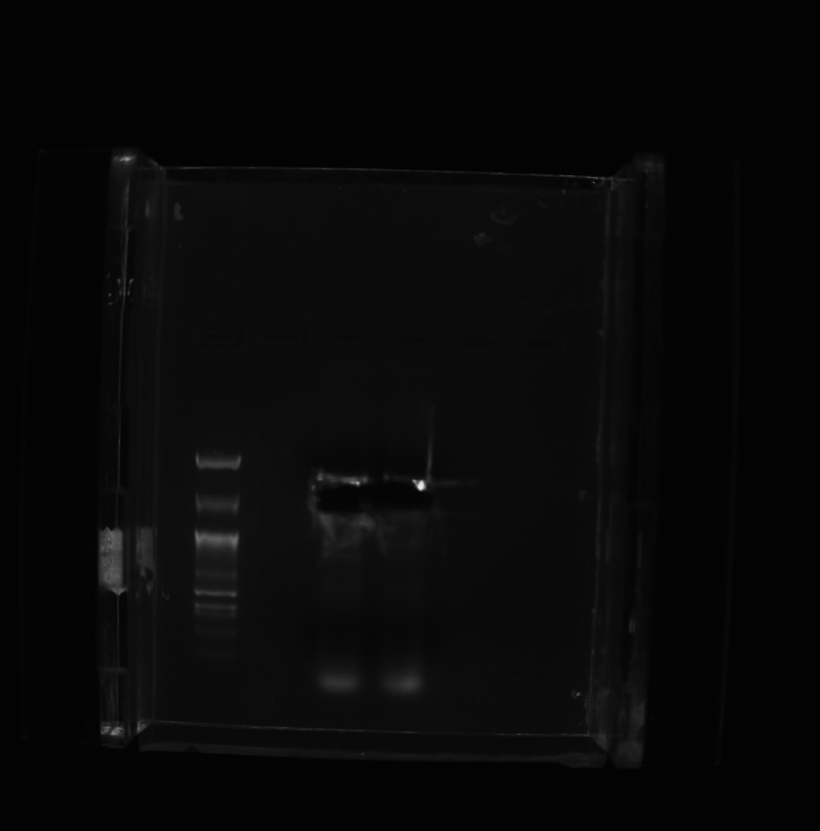
mLSS – insert amplification
Std
mLSS rv1
2229pb

Slide 15
mSC5D (full sequence) - primers testing
Marker VII
SC5D C1
SC5D C2
Nippon 100bp
Inserts
mSC5D C1 fw3/rv1 (63ºC)--> 3644pb
mSC5D C2 fw3/rv2 (65ºC)--> 3377pb
miR7 binding sites: 7mer-8 & 7mer-A1
3644pb
3000pb
1500pb

Slide 16
mSC5D (full sequence) – insert amplification
Marker VII
SC5D C1
SC5D C1
Nippon 100bp
3644pb
?
?

Slide 17
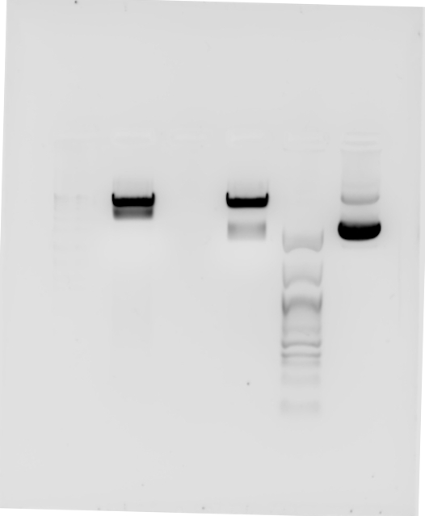
mLSS & mSC5D C1 – insert size check
Marker VII
SC5D C1
Nippon 100bp
psiCheck uncut
LSS
!
Control should have been psiCHECK cut

Slide 18
2
Inmunoprecipitation

Slide 19
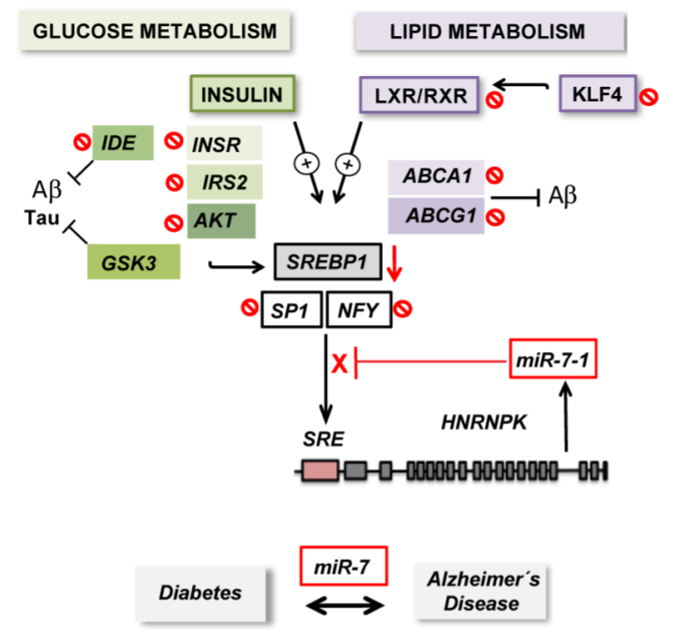
hnRNPK/miR-7 and insulin signaling

Slide 20
IP – Experiment 3
IP
Input
SB
IP
Input
SB
Std
t0
t12
t24
t0
t12
t24
t0
t12
t24
Std
t0
t12
t24
t0
t12
t24
t0
t12
t24
IRβ
Vinculin
hnRNPK
!
Different protein amount

Slide 21
IP – Experiment 4
IP
Input
SN
0h
12h
24h
0h
12h
24h
0h
12h
24h
IRS2
INSRβ
hnRNPK
¿GSK3β?
Vinculina
HSP90

Slide 22
IP – Experiment 5
IP
Input
SN
IP
Input
SN
Std
0h
12h
24h
0h
12h
24h
0h
12h
24h
Std
0h
12h
24h
0h
12h
24h
0h
12h
24h
hnRNPK
¿?
!
INSR didn’t work
!
GSK3β?

Slide 23
3
Flow cytometry

Slide 24
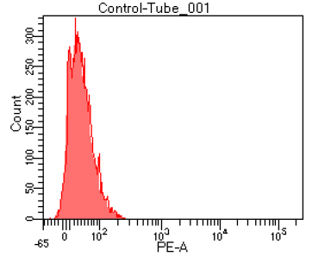
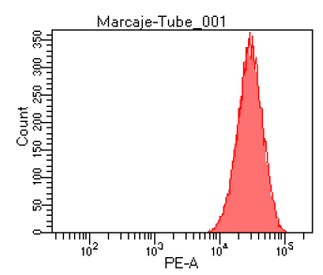
Flow cytometer test - 1
Two detectors in the range of Mitotracker Red
PE
PE-CF594

Slide 25
Flow cytometer test - 1
Two detectors in the range of Mitotracker Red:
PE
PE-CF594
PE-CF594 detects almost 3 times more fluorescence than PE

Slide 26
Flow cytometer test - 2
Q2 → double positives
Mitotracker Red
Mitotracker Green

Slide 27
MitoTracker Red/Green SH-SY5 n1
*

Slide 28
Future experiments
Repeat Mitotracker Red/Green in SH-SY5
Try MitoSOX staining in N2A
Electron microscopy
Clone 3’UTRs of human genes related to cholesterol metabolism: SC5D, DHCR7, DHCR24…
Luciferase assays
IGF1R, GSK3β and IRS2: assess if they inmunoprecipitate along with hnRNPK

Slide 29
IP – Experiment 1
IP 1
IP 2
Std
Inp
IP
SB
Std
Inp
IPA
IPB
SB
Std
!
No sonication
IP 1
IP 2
Std
Inp
IP
SB
Std
Inp
IPA
IPB
SB
Std
hnRNPK
o
IRβ
x

Slide 30

IP – Experiment 2
IP: scbt
WB: cs
IP: cs
WB: scbt
Std
Std
150 kD
100 kD
¿INSR?
75 kD
hnRNPK
50 kD
IP
SB
IP
SB
Input
Input

